Slide 1

Saqr M. Ereiqat
BlockChain Evangelist
@DxBlockChain

Slide 2
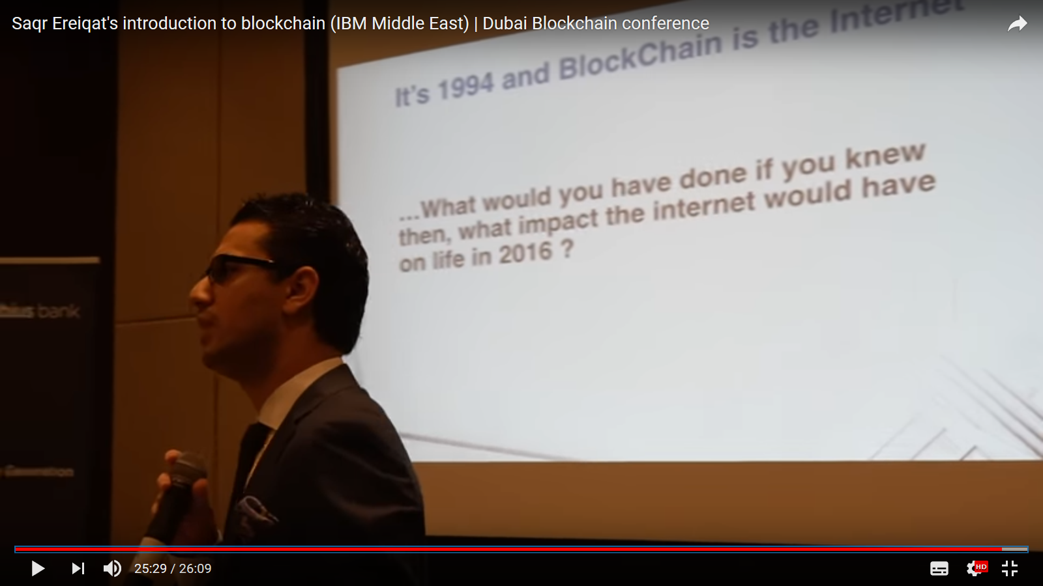

Slide 3
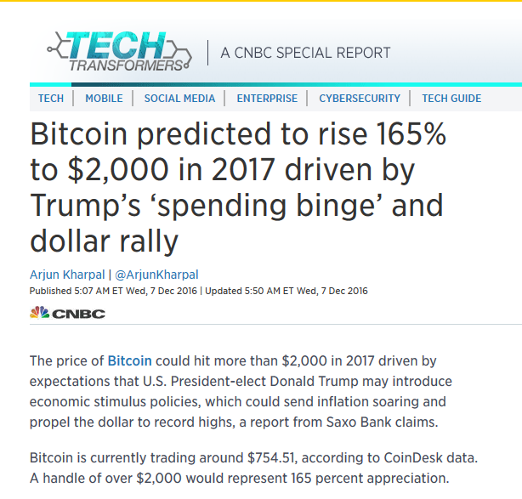
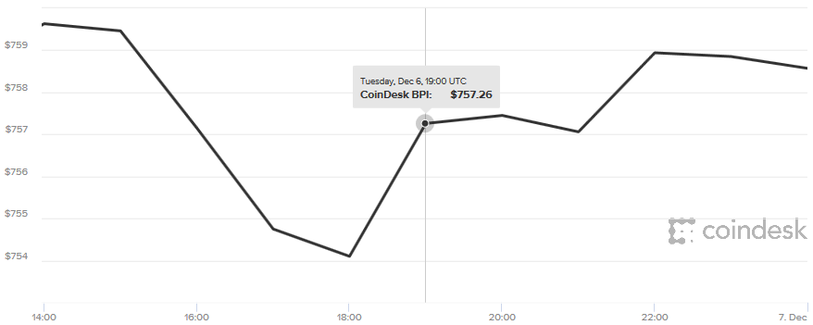
One Year Ago – Cryptocurrencies

Slide 4






Blockchain for enterprise

Slide 5

Information is exploding
  “There was five exabytes of information created between the dawn of civilization through 2003, but that much information is now created every two days, and the pace is increasing”.
  Eric Schmidt, former CEO of Google, 2010
Internet traffic growth in 24 months: from 49 exabytes to 75 exabytes
By 2020
44,000,000,000,000,000,000,000
Zettabyte
Exabyte
Petabyte
Terabyte
Gigabyte
Megabyte
Kilobyte
Byte

Slide 6

DATA IS
THE NEW OIL

Slide 7


Slide 8
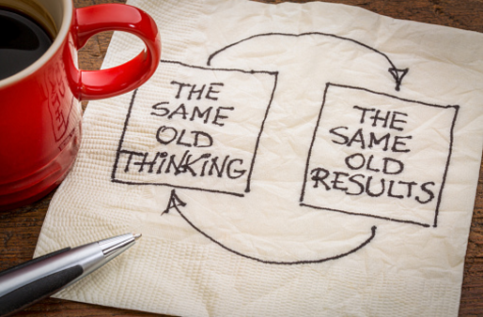






Government challenges are escalating, the status quo is unsustainable…

Slide 9

Blockchain will revolutionize 21c public service delivery the way the Internet revolutionized 20c communication
Blockchain

Slide 10

Blockchain is the enabler…

Slide 11


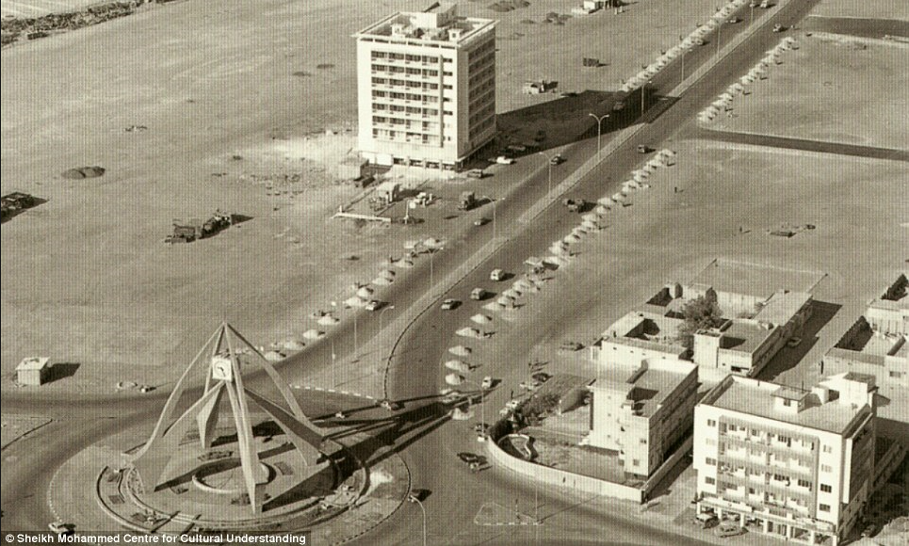
Visionaries will harness Blockchain to drive radical transformation

Slide 12
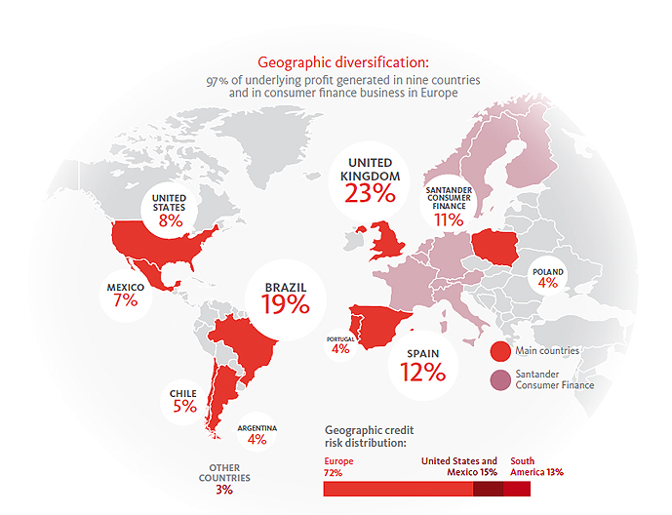
Banco Santander operates across the globe
193,863
employees
121M
customers
€6.2Bn
profit
First in
market cap
Eurozone

Slide 13





Example: Utility Settlement Coin transforms transactions
Bank A
Bank B
Blockchain
Digital currency stored in
USC pseudo-central bank

Slide 14












Example: Securing trust in global trade
Automated Administration
Real-time
Tracking
Tamper Proof
Documents
Smooth Logistics
Exporter & Exporters Bank
Freight Forwarder
Port Exit & Customs
Ocean
Carrier
Port of
Entry
Import
Customs
Importers
Bank
Importer

Slide 15
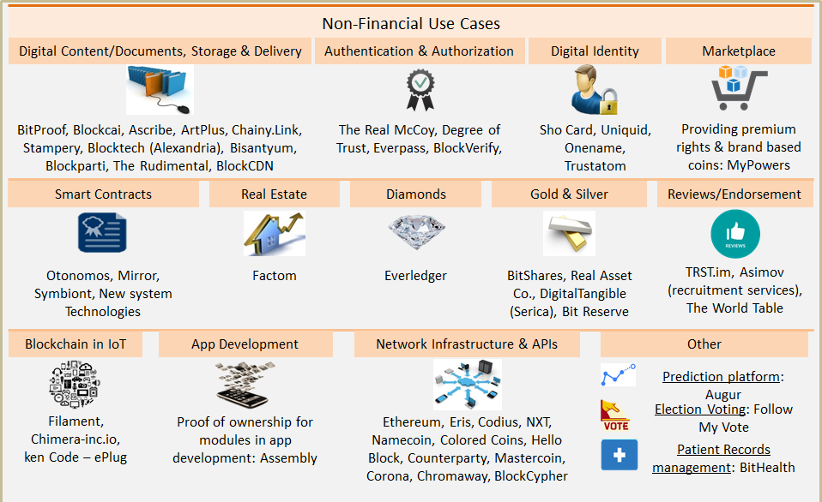
List of Use Cases Goes On and On ….
https://letstalkpayments.com/
an-overview-of-blockchain-technology/

Slide 16


First movers will set the vision for the world!

Slide 17
Thank You

